Slide 1
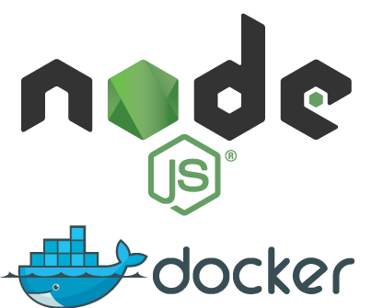
Lab 0: Getting Setup
Installing the tools needed for local development with Docker and deploying to AWS
Time to finish: ~15 min

Slide 2
Task
0-installs
You must have the following items:
Slides, labs and code: https://github.com/stellarsquall/docker-intermediate/
Node and npm (v6 and v4)
Docker engine
AWS account (ask for access to mine if needed)
AWS CLI

Slide 3
Walk-through
0-installs
If you would like to attempt the task, skip the walk-through and go for the task directly. However, if you need a little bit more hand holding or you would like to look up some of the commands or code or settings, then follow the walk-through.
1. Slides, labs and code
Open this link in your browser https://github.com/stellarsquall/docker-intermediate and click on the green button that says “Clone or Download”.
Alternatively, use Git clone (you can fork first too):
git clone https://github.com/stellarsquall/docker-intermediate.git
Or download with CURL and unzip (create a new folder):
curl https://codeload.github.com/stellarsquall/docker-intermediate/zip/master | tar -xv
2. Node and npm
To install Node v6, your oﬃcial installer (link) or nvm (recommended).
To install nvm (node version manager), run this script:
curl -o- https://raw.githubusercontent.com/creationix/nvm/v0.33.2/install.sh | bash
Then run one of the nvm commands such as:
nvm install node
Keep in mind that after installing and/or switching between versions with nvm, you might have to restart your terminal session (depends on your PATH settings).
Check Node and versions with:

Slide 4
0-installs
node --version
npm --version
You need to have Node v6 or v8 and npm v4+.
3. Docker engine
Next, you would need to get the Docker engine (deamon). If you are a macOS user like I am, then the easiest way is to just go to the oﬃcial Docker website https://docs.docker.com/docker-for-mac.
For other platforms, you can select one of the options from this page: https://docs.docker.com/engine/installation.
To verify installation, run
docker version
It’s good if you see something like this:
Client:
Version: 17.03.1-ce API version: 1.27
Go version: go1.7.5 Git commit: c6d412e
Built: Tue Mar 28 00:40:02 2017
OS/Arch: darwin/amd64
Server:
Version: 17.03.1-ce
API version: 1.27 (minimum version 1.12) Go version: go1.7.5
Git commit: c6d412e
Built: Fri Mar 24 00:00:50 2017
OS/Arch: linux/amd64 Experimental: true
Next step is to verify that Docker can pull from Hub. Run this hello world image:
docker run hello-world
If you see a message like this, most likely you didn’t start Docker:

Slide 5
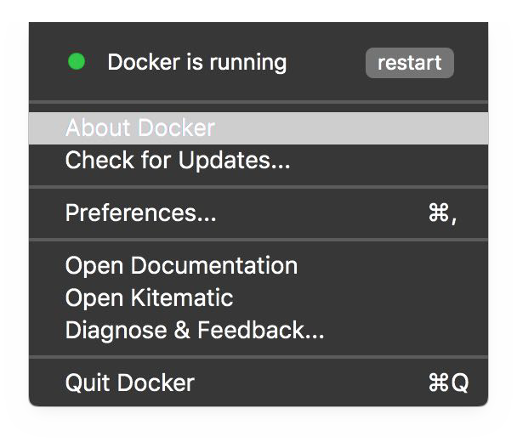
0-installs
Cannot connect to the Docker daemon. Is the docker daemon running on this host?
Start Docker. If you used macOS, you can utilize the GUI app. Otherwise, CLI.
This is how running Docker daemon looks on my macOS:
On the contrary, if you see a message like the one below, then deamon is running and you are ready to work with Docker!

Slide 6
0-installs
Unable to find image 'hello-world:latest' locally latest: Pulling from library/hello-world
c04b14da8d14: Pull complete
Digest: sha256:0256e8a36e2070f7bf2d0b0763dbabdd67798512411de4cdcf9431a1feb60fd9 Status: Downloaded newer image for hello-world:latest
Hello from Docker!
This message shows that your installation appears to be working correctly.
To generate this message, Docker took the following steps:
...
4. AWS account
You can easily get a free (trial) AWS account. You’ll need a valid email and a credit card. Read about the free tier at https://aws.amazon.com/free/ and when you are ready, sign up by clicking on “CREATE A FREE ACCOUNT”.
Once you are in, make sure you can access EC2 dashboard. Sometimes AWS requires a phone call or a waiting period. Most people can get an account within 10 minutes.

Slide 7
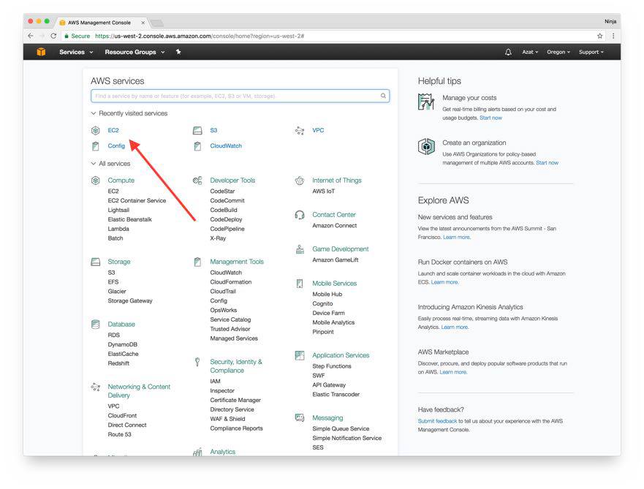
0-installs
5. AWS CLI
Check for Python. Make sure you have 2.6+ or 3.6+. You can use pip (Python package manager) to install AWS CLI.
phyton --version pip --version
pip install awscli
AWS CLI installation command for El Capitan users:
sudo -H pip install awscli --upgrade --ignore-installed six

Slide 8
0-installs
Python at least 2.6.5 or 3.x (recommended), see here: http://docs.aws.amazon.com/cli/latest/userguide/cli-chap-welcome.html. At https://www.python.org/downloads/ you can download Python for your OS.
Other AWS CLI Installations
Install the AWS CLI with Homebrew - for macOS
Install the AWS CLI Using the Bundled Installer (Linux, macOS, or Unix) - just download, unzip and execute
Install the AWS CLI for Windows – MSI installation or python instructions
Verify AWS CLI
Run the following command to verify AWS CLI installation and its version (1+ is ok):
aws --version

